Slide 1
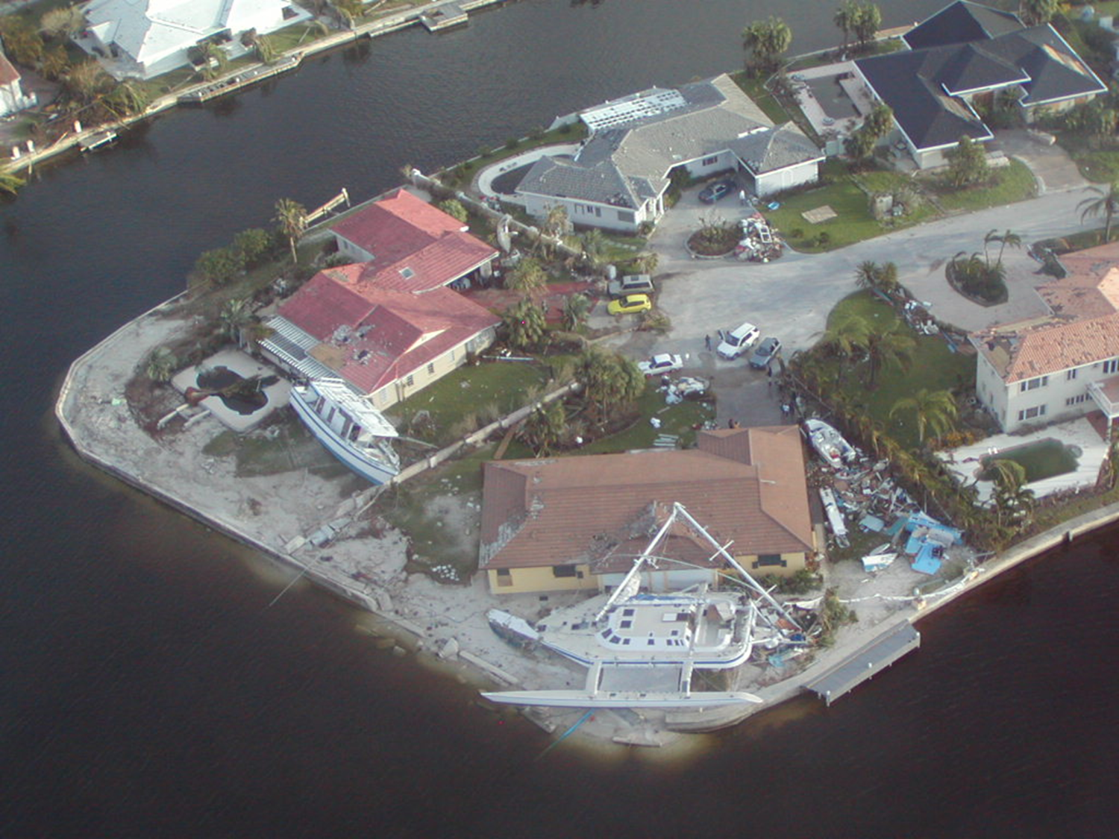
Aspects of Caribbean Sustainable Development
Dr David C. Smith, Coordinator, Institute for Sustainable Development, The UWI

Slide 2
A brief history
PhD. (Zoology) 1988, Lecturer, Department of Zoology, University of the West Indies
Executive Director of the Jamaica Conservation and Development Trust, an environmental not-for-profit organization
Regional Councilor for IUCN-The World Conservation Union 1994-2000; Chair of the Business Committee, member World Commission on Protected Areas.

Slide 3
A brief history
Programme Specialist (Environment, Disaster Management & Climate Change) at UNDP Office in Jamaica (covered The Cayman Islands, The Bahamas, Bermuda, The Turks and Caicos Islands and Jamaica)
Assistant Resident Representative (Programme) UNDP
Coordinator, Institute for Sustainable Development, University of the West Indies.

Slide 4
Caribbean Environment
Rainfall 300 – 6500 mm per annum
Low: Puerto Rico (CI website op.cit.)
High: Millbank, Jamaica (Met Office Jamaica)
Extent of the sea 2,640,000 km² (UNEP)
Extent of the Land 229,549 km² (CI)
Tropical Forest: Lowland and Montane
Savannah and arid lands
Coral Reefs, Shallow shelves and deep trenches
Cayman Trench about 7500 m below sea level
Wetlands and Rivers

Slide 5
The University of the West Indies
A multi-national University with campuses in
Barbados
Jamaica
Trinidad &Tobago
and a virtual campus.
Serves 17 English-Speaking Caribbean nations
One of two such Universities in the World (University of South Pacific is the other).

Slide 6
Institute for Sustainable Development at the UWI
Researches key issues that affect Sustainable Development in Caribbean SIDS.
Security
Environmental Management
Energy
Disaster Risk Reduction
Teaches at the postgraduate level
Links with CARICOM and the UN Sustainable Development Solutions Network

Slide 7
Current research at ISD, UWI
Design, construction and operation of a zero energy or net-energy (ZEN+) building which is also hurricane resilient
ERGO – adapting Earthquake risk estimation software to the Caribbean (with University of Illinois & UWI Seismic Research Centre) and better estimation of earthquake hazard (Jamaica & Barbados).

Slide 8
Current research at ISD, UWI
Effects of
hazards on: livelihoods & communities,
land tenure on vulnerability,
Climate on crops, fisheries and agriculture,
Security on development
Estimating flood hazards.

Slide 9
Policy support at ISD UWI
National Security Policy and policing – Jamaica
Green Economy transitioning – Caribbean SIDS and Jamaica
Economic Evaluation of Natural Resources & Ecosystem Services – Jamaica
Effect of disasters on development

Slide 10
Teaching and Learning
The ISD through its Centre for Environmental Management offers a M.Sc. in Natural Resource Management
Marine and Terrestrial Ecosystems
Integrated Urban and Rural Environmental Management
Disaster Management
We are working to have many of the modules available online in the next two years.

Slide 11
Future

Slide 12
SDGs and Environment
2 Zero Hunger
6 Clean Water
7 Affordable and Clean Energy
11 Sustainable Cities
13 Climate Action
14 Life below water
15 Life on Land

Slide 13
Global risks
Climate Change
Changed rainfall patterns leading to increased drought and floods
Pattern of extreme weather events will change
Effect of weather on development will increase
The Sea level will rise
This will happen in the tropics before the rest of the world.

Slide 14
The Caribbean & the tropics
Unprecedented climates will occur earliest in the tropics starting around 2023 in Indonesia & Jamaica.
“Global mean ocean pH moved outside its historical variability in 2008 (±3 years s.d.).” Mora et. al.
Raven, J. A. et al. (eds). Ocean Acidification due to Increasing Atmospheric Carbon Dioxide (Royal Society, 2005).
Zeebe, R. E., Zachos, J. C., Caldeira, K. & Tyrrell, T. Carbon emissions and acidification. Science 321, 51–52 (2008).

Slide 15
Major environmental threats to the Caribbean (related to CC)
Vector-borne diseases
Zika Virus
Chikungunya
Dengue
Malaria
Et al …….
Drought
Increased temperature & sea-level rise
Will the availability of Fresh Water be affected by Climate Change?
Will increased temperature increase energy (cooling) costs?
Is tourism under threat from the sea?

Slide 16
Dependence of the economy on natural resources
If beach erosion rates remain as they were in 2011, then by 2021, beaches in Negril, Montego Bay & Ocho Rios will lose value of US$19 million annually.
If reefs degrade further, the additional beach erosion will increase this loss to US$33 million per annum.
The erosion could reduce tourist visitation by 9,000 to 18,000 stopover visitors annually; costing the industry between US$9 & US$19 million annually and costing the entire economy between US$11 to US$23 million annually.
Kushner, B., P., Edwards, L. Burke, and E. Cooper. 2011. Coastal Capital: Jamaica. Coral Reefs, Beach Erosion and Impacts to Tourism in Jamaica. Working Paper. Washington, DC: World Resources Institute.

Slide 17
Possible areas of research
Climate adaptation
Water
Purifying water for rural impoverished communities
Drought preparation
Agriculture and water efficiency
Climate and epidemiology
Coastal zone management
Disaster Risk Reduction

Slide 18
Possible areas of research
Energy
Increasing Efficiency
Applying Renewable Energy
Cleaning energy generation
Economics and Environment
Valuing environmental goods and services
Managing ecosystem services
Fisheries management

Slide 19
Thank You

